Slide 1
To-do List Manager
Team Details:
1.) Aryan Goel_2410990269 (leader)
2.) Avneet Lamba_2410990270
3.) Ayushi_2410990272
Faculty Coordinator: Dr. Gaganpreet Kaur
:
Chitkara University Institute of Engineering and Technology,
Chitkara University, Punjab

Slide 2
Table of Contents
Introduction
Problem Statement
Technical Details
Key Features
Project Highlights
Conclusion
References/Links used

Slide 3
Introduction
Title of the project – To-do List Application
The team members' names : Aryan Goel, Ayushi, Avneet Lamba.
The purpose of the project is to make a user-friendly interface to manage, organize tasks. It helps a person to keep an eye over the tasks that are to be done. The user can create, edit, mark the task as done and delete it as well.
By this way the user will keep all his planned work organized and in one place, without having any mental pressure to remember each task separately.

Slide 4
Problem Statement
In today’s modern world, majority of the people find it difficult to memorize and manage their tasks and activities through traditional methods such as paper lists or in mind. The new generations need some digital platform to manage all their work. So here pops up the requirement of a digitalized to-do list application.

Slide 5
Technical Details
Basic technologies and methods used :
HTML (Hyper Text Mark-up Language) :
For basic structuring of the user interface.
CSS (Cascading Style Sheets) :
For styling the user interface. For example – to alter the font style, size, colour and spacing between the content.
Java script :
For adding functionality and interactivity to the webpage. To make it more dynamic and responsive.

Slide 6
Key Features :
Login/Signup :
The user can create an account and login into it to maintain the authenticity and have a personalized experience.
To-Do List creation and management :
Create your list : Create your list by naming it according to your requirement.
Personal/Team : Choose whether you need a personal list or a list for your work purpose which involves task addition for your team members.
Add task : The user can add a task to the list by writing task description.

Slide 7
Audio assistant : User can dictate the task using the audio assistant button for more convenience.
Set deadlines : The user can set deadlines for the task assigned to the respective team member.
Mark as done : The user can mark the task as done.
Delete task : The user can delete the task once it is completed.
Progress : One can track the progress by knowing the percentage of the tasks completed from the progress bar.
To-Do List Manager : The user can observe and manage all the to-do lists created at one place.

Slide 8
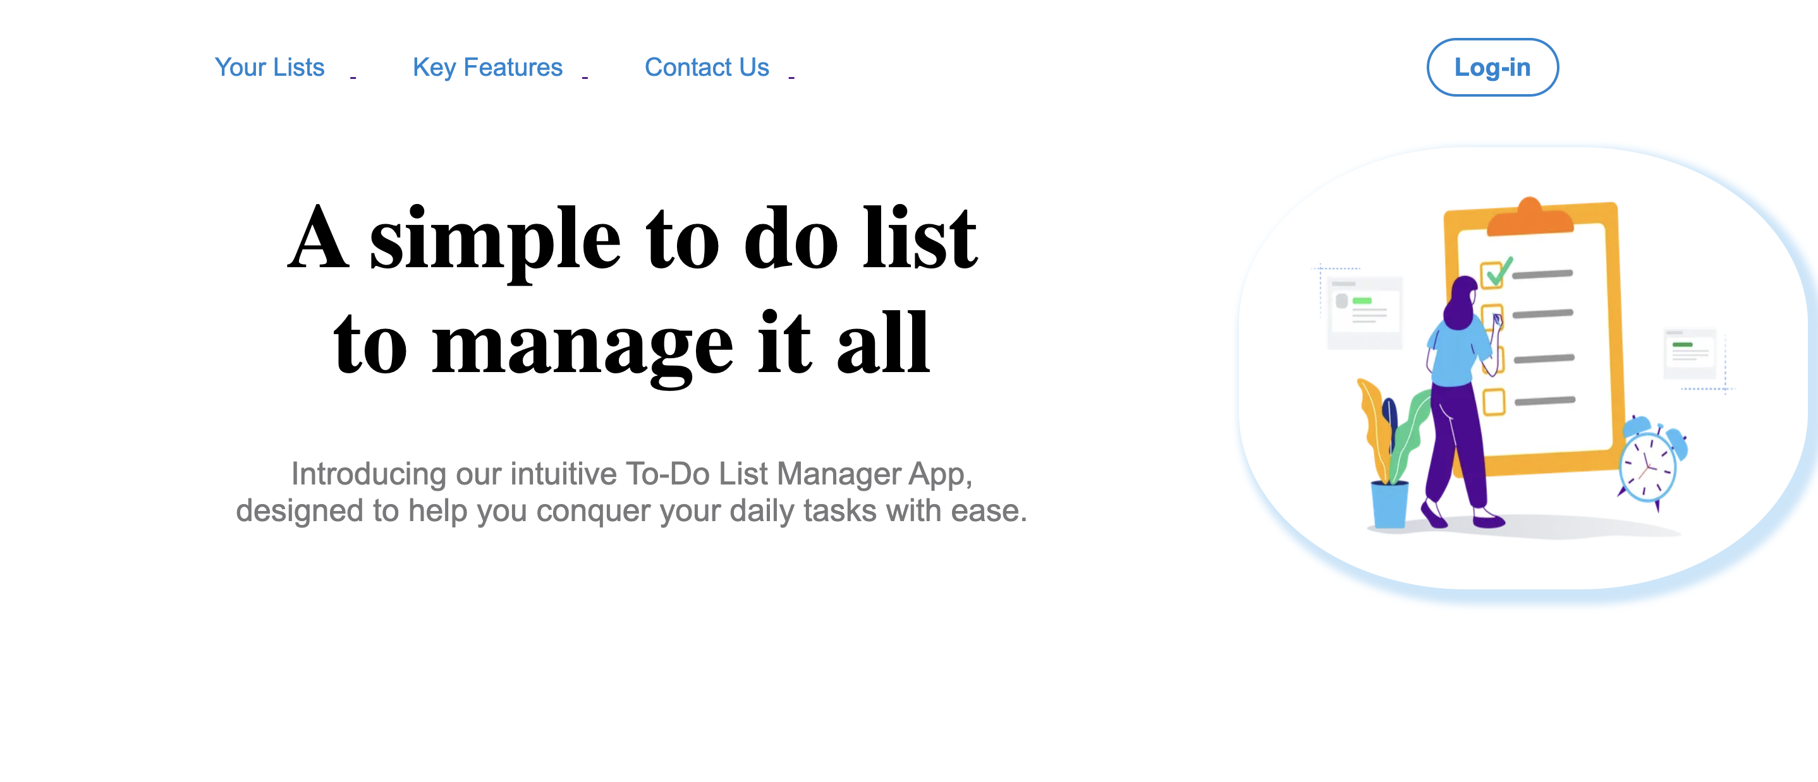

Slide 9
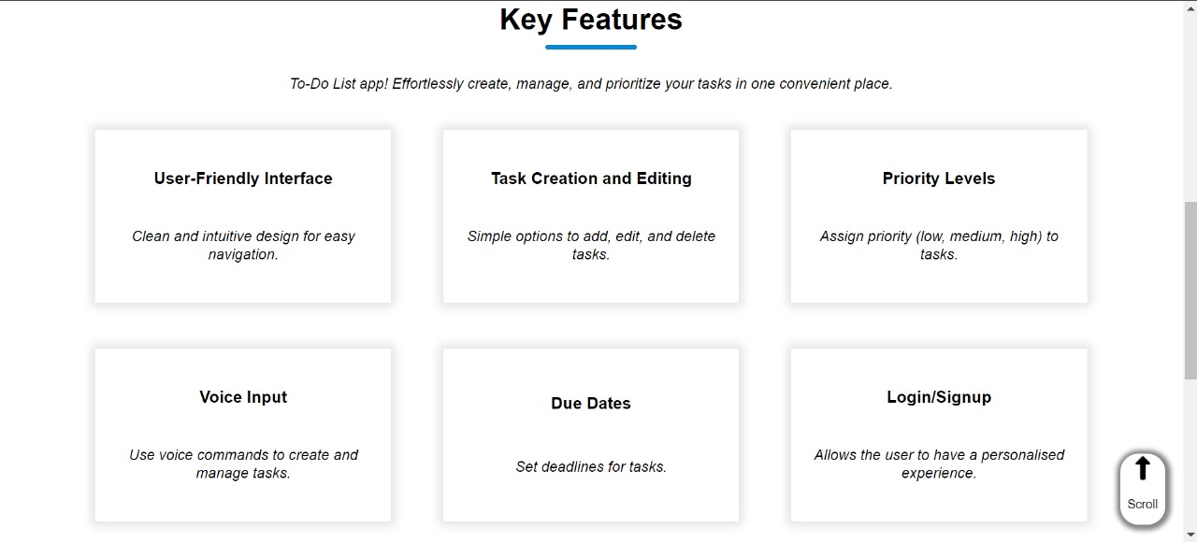

Slide 10
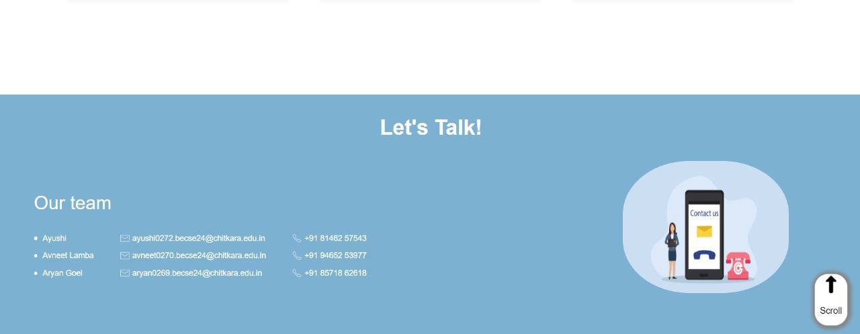

Slide 11
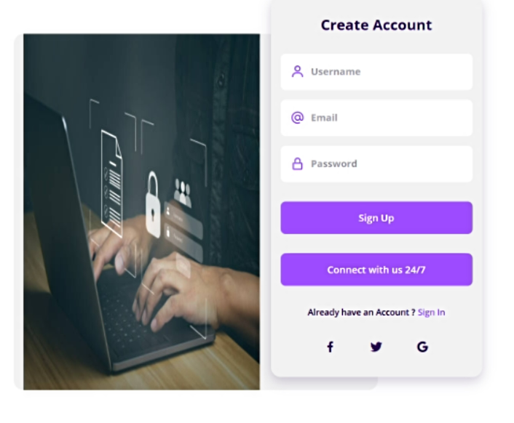
Project Highlights

Slide 12
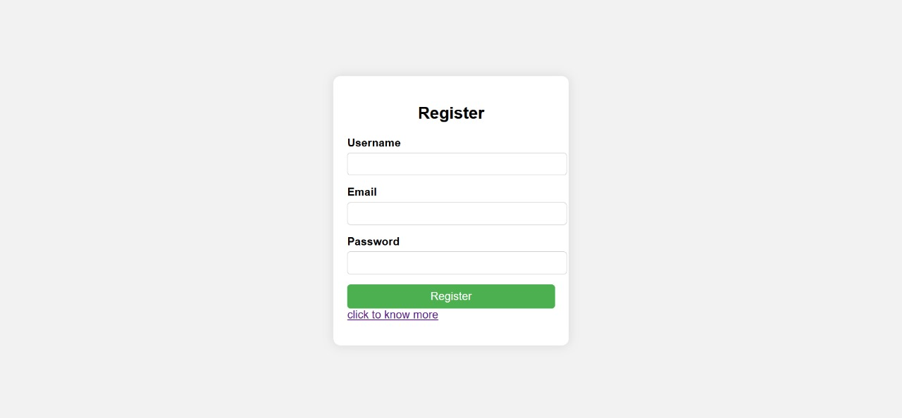

Slide 13
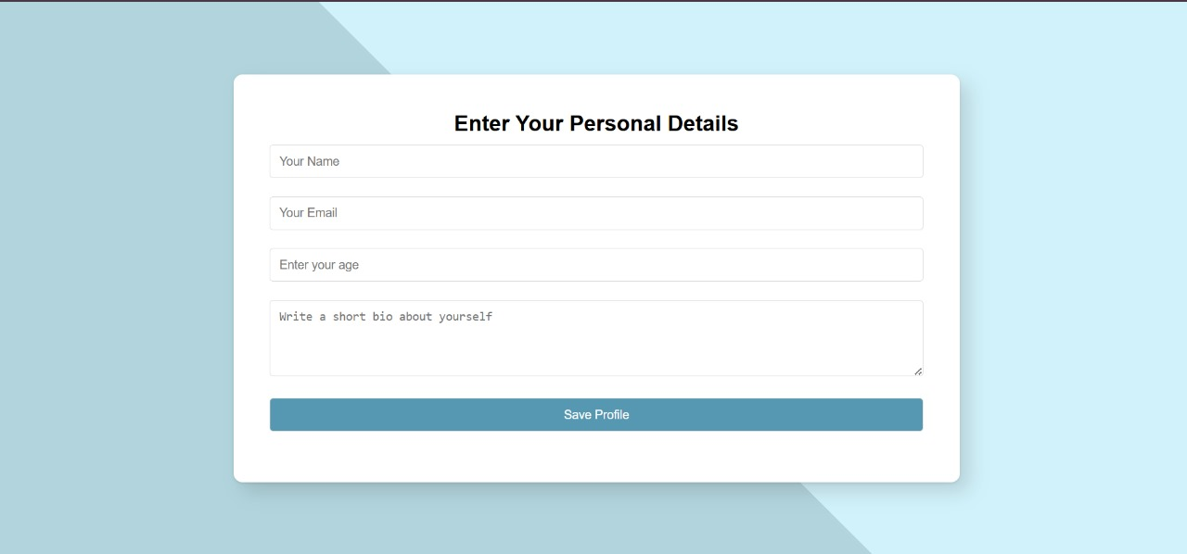

Slide 14
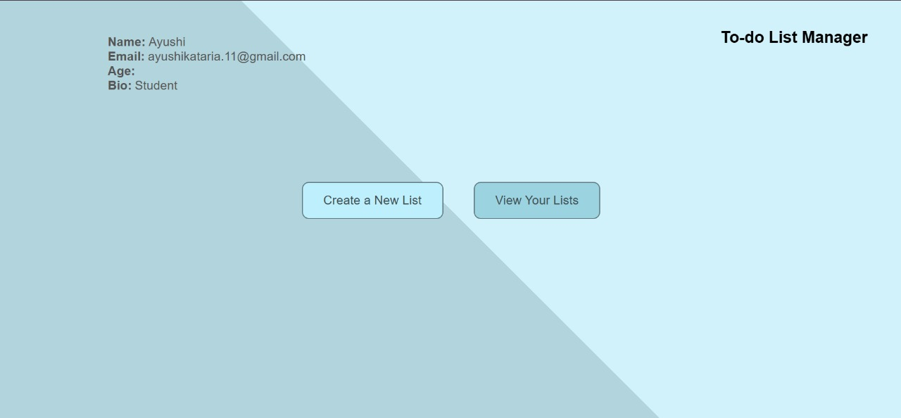

Slide 15
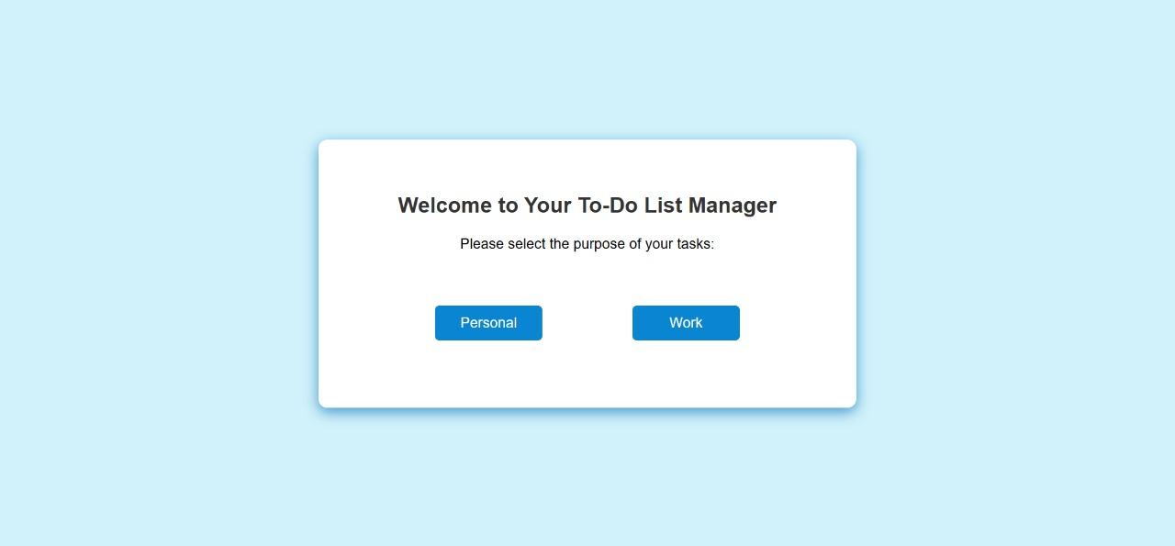

Slide 16
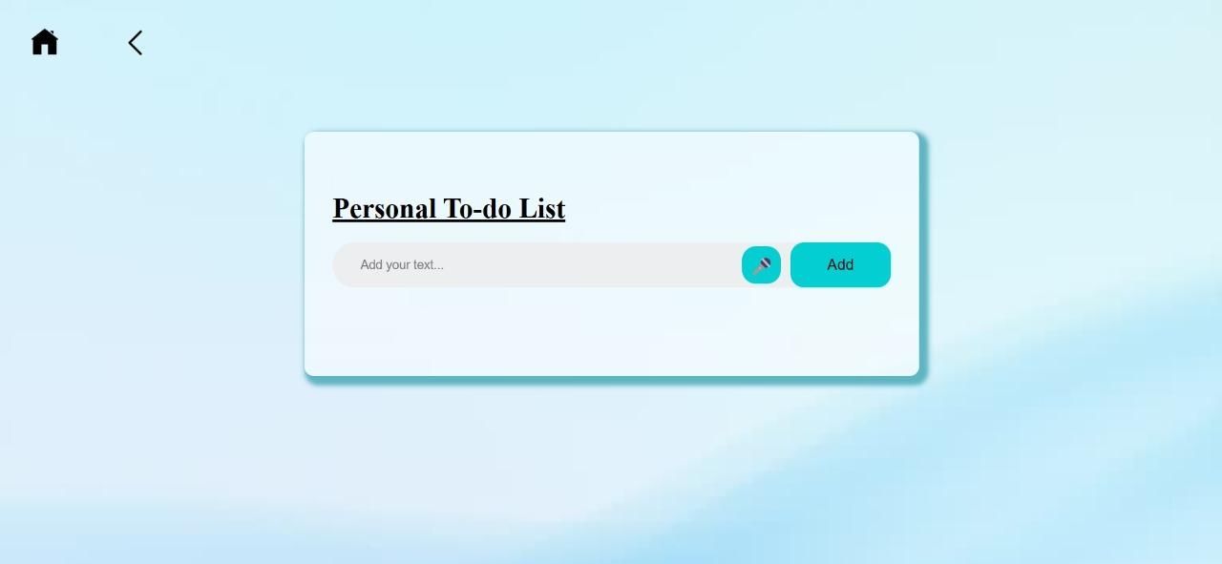

Slide 17
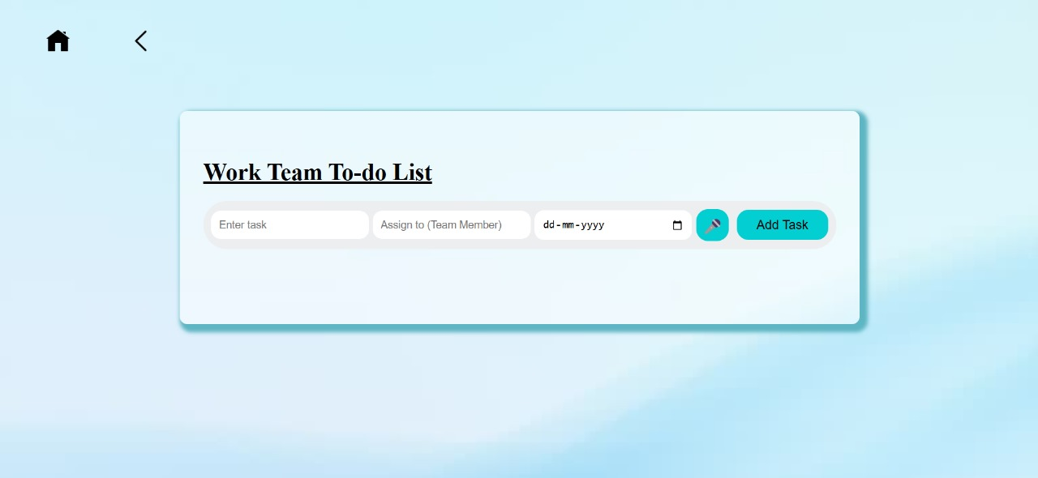

Slide 18
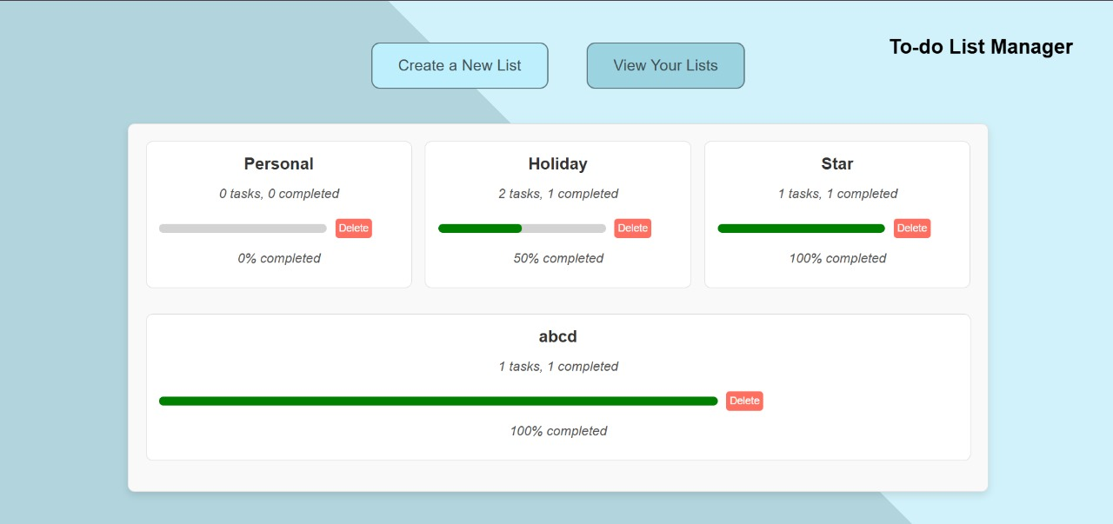

Slide 19
Conclusion
Key points of the To-Do List Project
User interface :
Designed a simple user-friendly interface to handle the list conveniently.
User privacy :
Included login and account creation for authenticity.
Task management :
Users can add, audio-assist, edit and mark tasks as completed.
Lists management :
Users can manage the overall lists they have created in the to-do list manager page.
Task completion progress is also visible here at the same place.

Slide 20
Main takeaways from the experience
Collaboration and Team work :
Involved equal distribution of duties, which helped us being responsible for our work.
Importance of security :
Learnt how user security is must in every application which is being used on a personal level.

Slide 21
References/Links used
Reference of home page : https://www.any.do/
Links used :
Background image :
Login page, to-do list page - https://media.istockphoto.com/id/1594072752/video/blue-soft-wave-material.jpg?s=640x640&k=20&c=7cyVE-wS7SuXfPi0CIfFEzXnIGRZjJoMnoFkwOSVXcM=
To do list icon : https://cdn.pixabay.com/photo/2022/05/22/17/22/to-do-7214069_1280.png
Audio assist button : iconfinder.com

Slide 22


